Slide 1
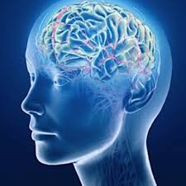
Brain Tumor Classification Convolutional neural network Ali Mahzoon

Slide 2
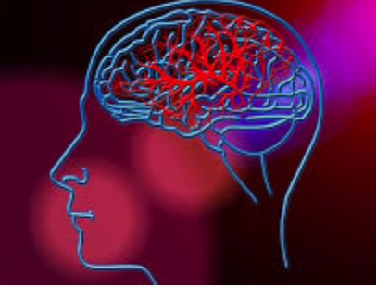
Overview
A Brain tumor is considered as one of the aggressive diseases, among children and adults. Every year, around 12,000 people are diagnosed with a brain tumor. The 5-year survival rate for people with a cancerous brain or CNS tumor is approximately 34 percent for men and 36 percent for women.
The best technique to detect brain tumors is Magnetic Resonance Imaging (MRI). These images are examined by the radiologist. A manual examination can be error-prone due to the level of complexities involved in brain tumors and their properties.
Hence, proposing a system performing detection and classification by using Deep Learning Algorithms using Convolutional Neural Network (CNN), Artificial Neural Network (ANN), and Transfer Learning (TL) would be helpful to doctors all around the world.

Slide 3
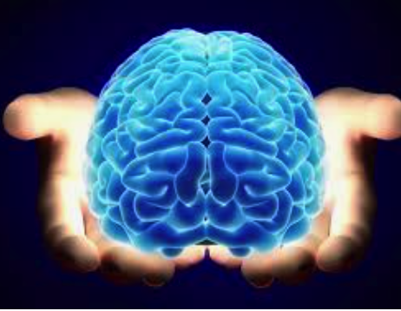
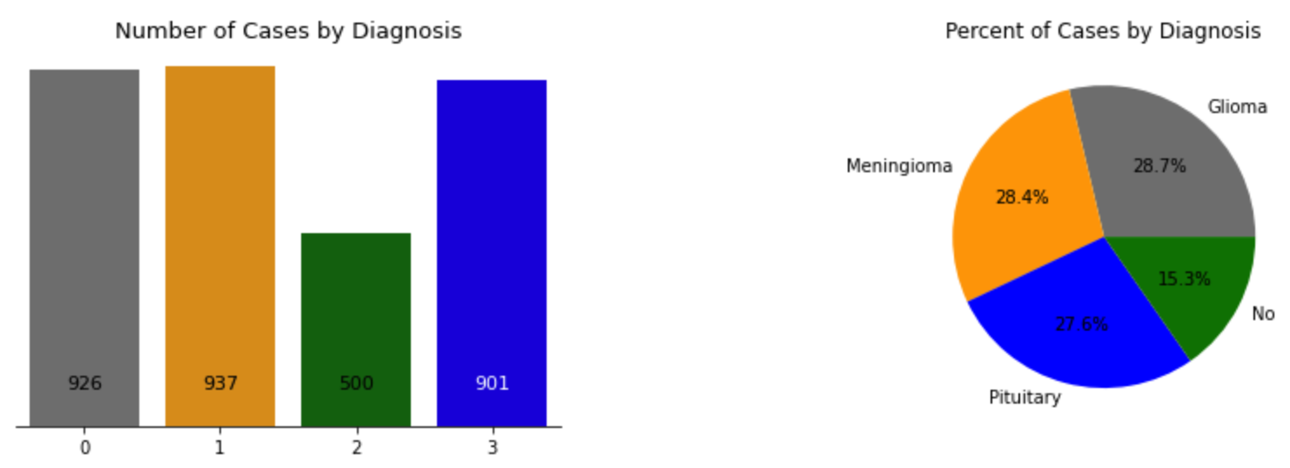
Dataset
I used a provided dataset by Kaggle
In this dataset we are dealing with 3264 images
Created a multiclass model to classify these images into 4 classes.
1. Glioma
2. Meningioma
3. No Tumor
4. Pituitary

Slide 4
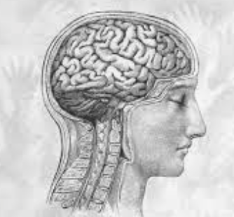
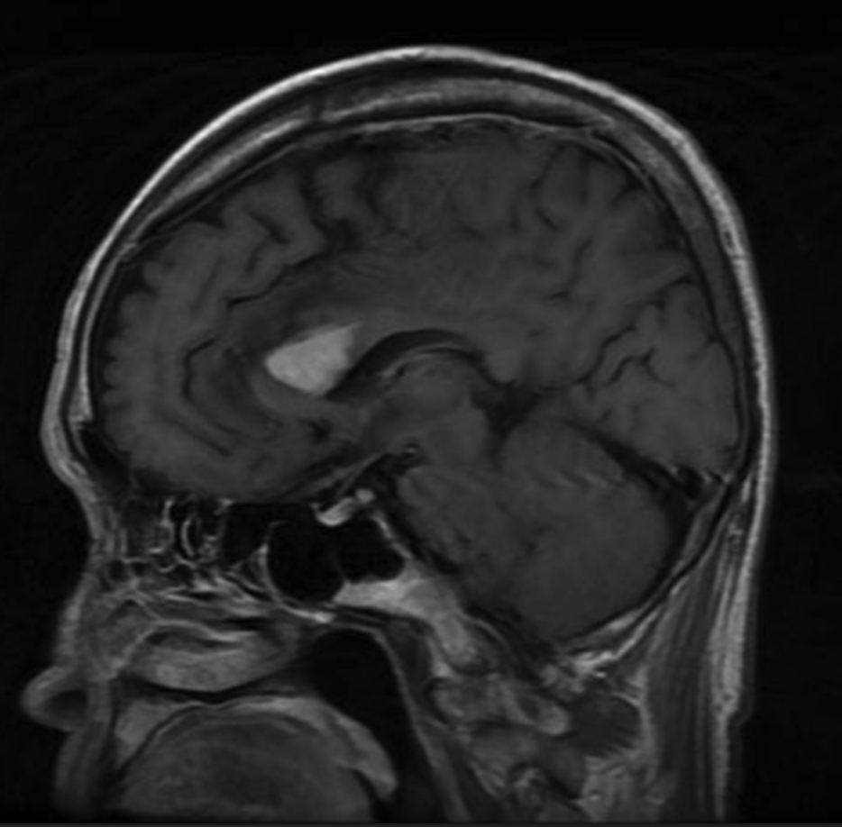
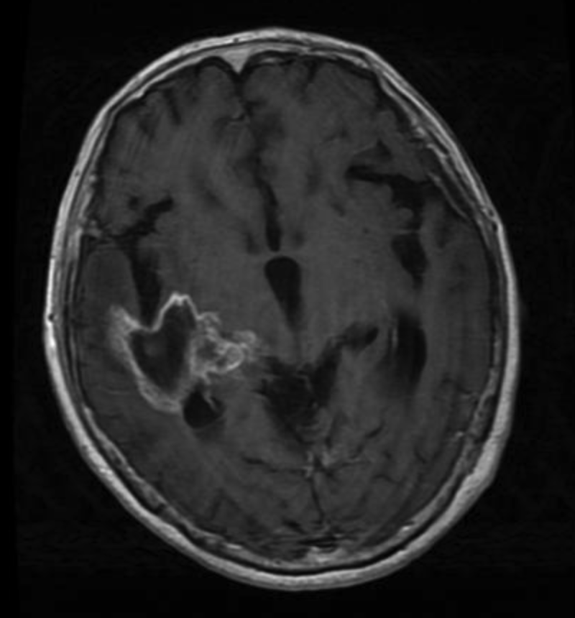
Examples Of Data
Glioma Tumor
Different Scans
Different views

Slide 5
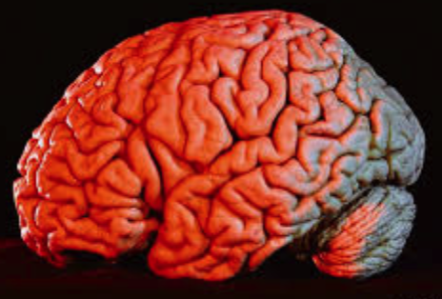
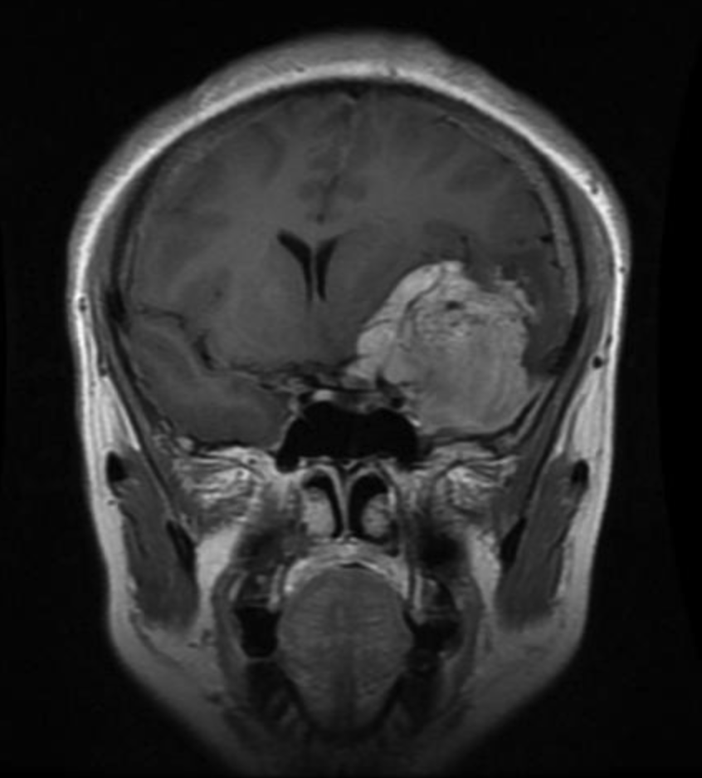
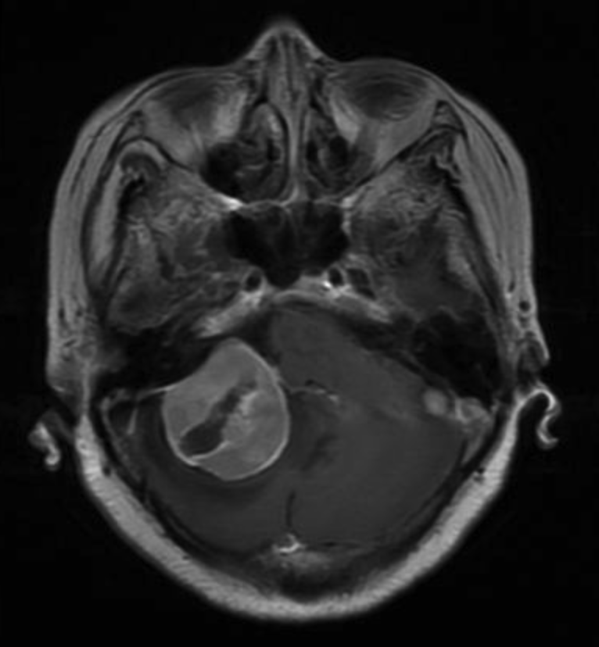
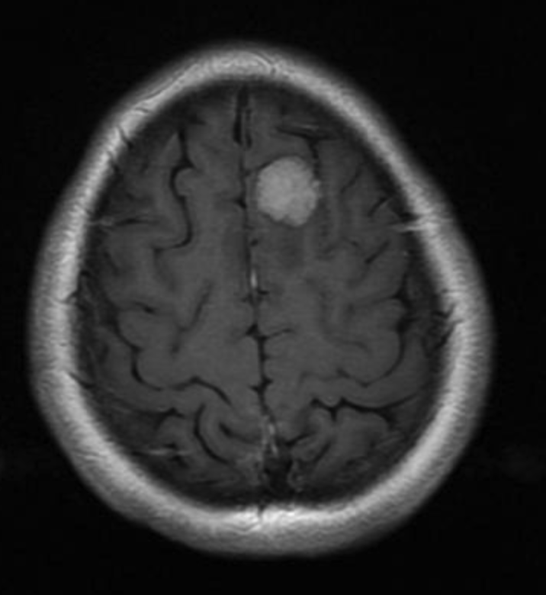
Examples Of Data
Meningioma Tumor
Different Scans
Different views

Slide 6
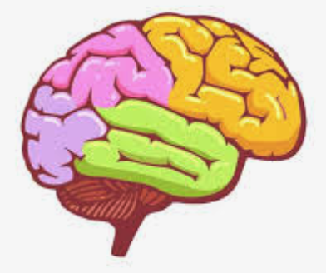
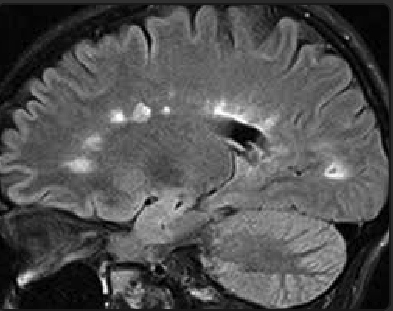
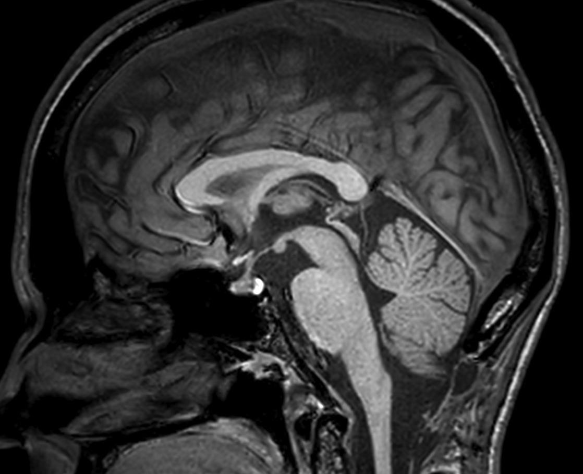
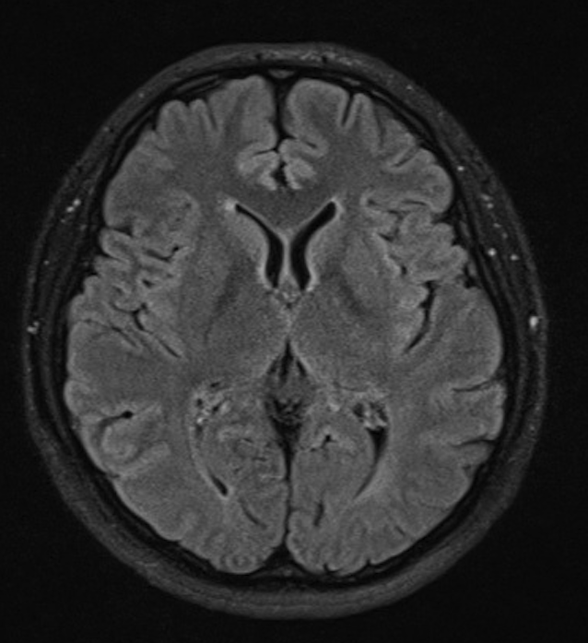
Examples Of Data
No Tumor (Healthy)
Different Scans
Different views

Slide 7
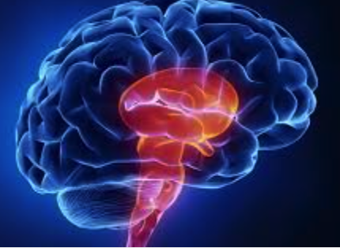
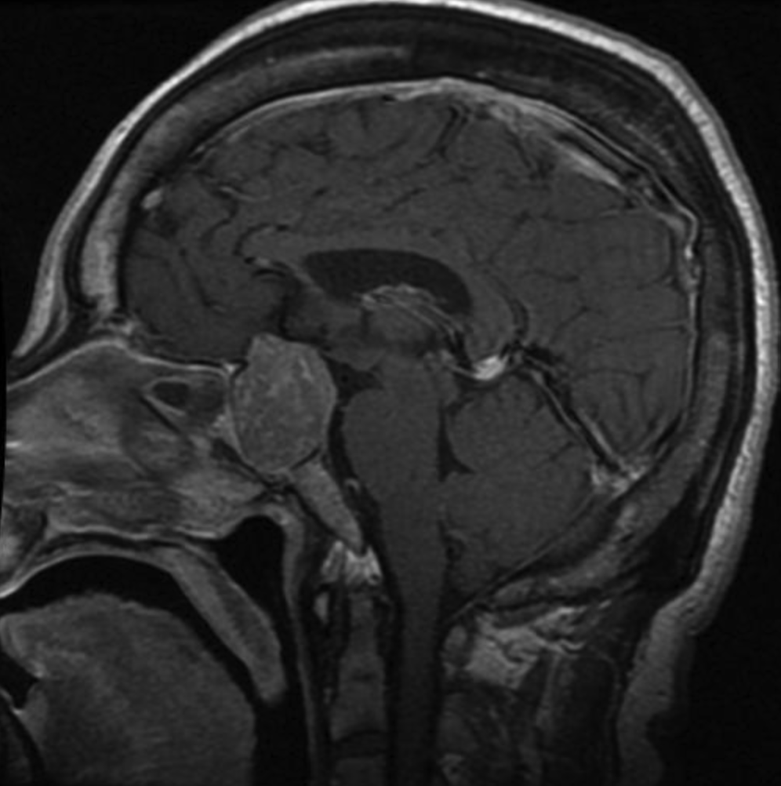
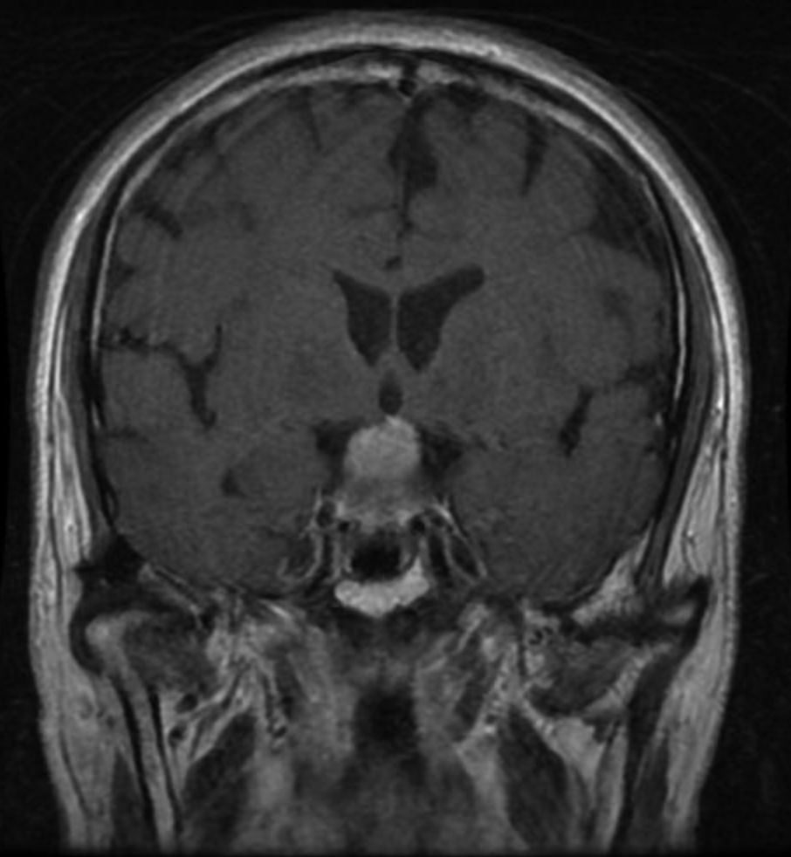
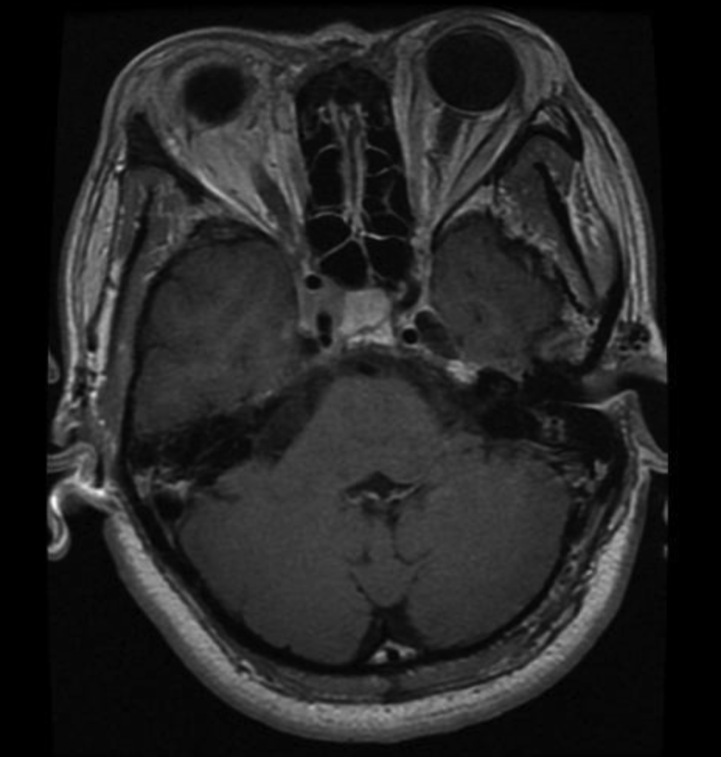
Examples Of Data
Pituitary Tumor
Different Scans
Different views

Slide 8
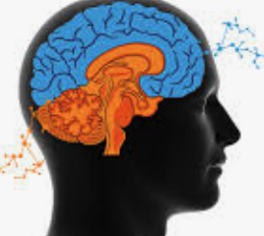
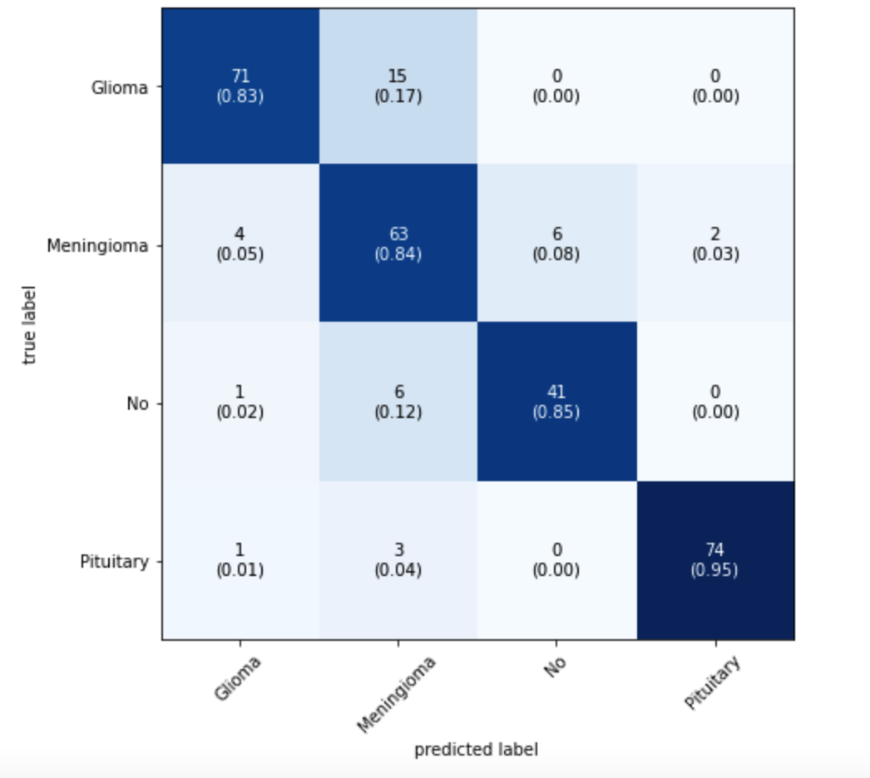
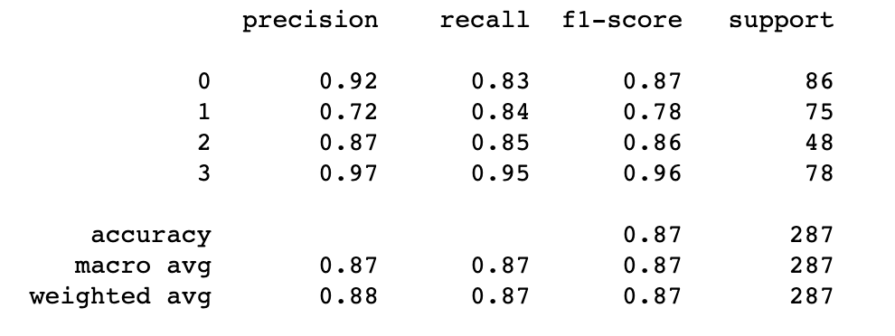
Models Designed various models from NN to pretrained CNN models
Glioma
Meningioma
No
Pituitary
These are the best Confusion matrix and evaluation metrics of validation set that I could get from my best design.

Slide 9
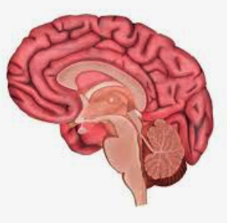
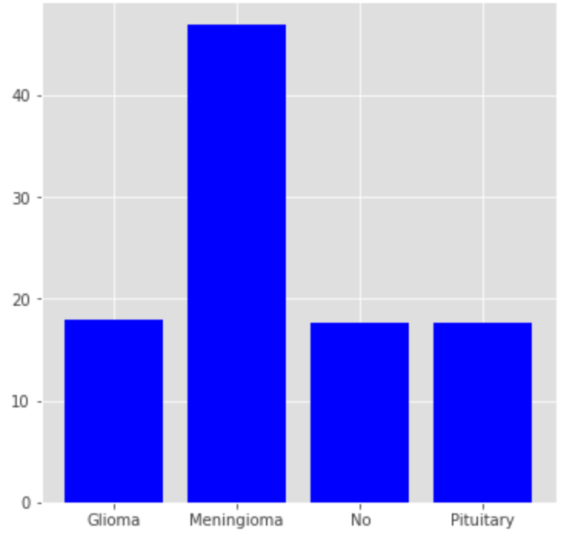
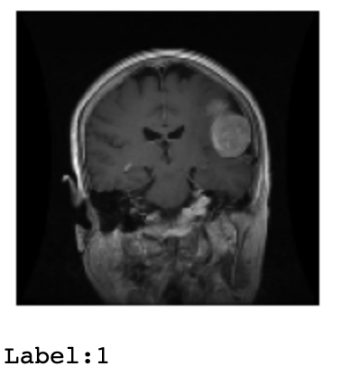
Plotting Images and the results
Meningioma

Slide 10
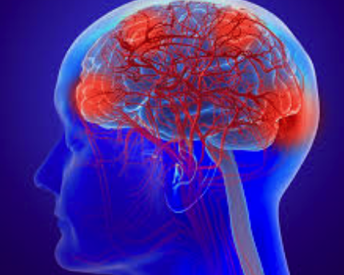
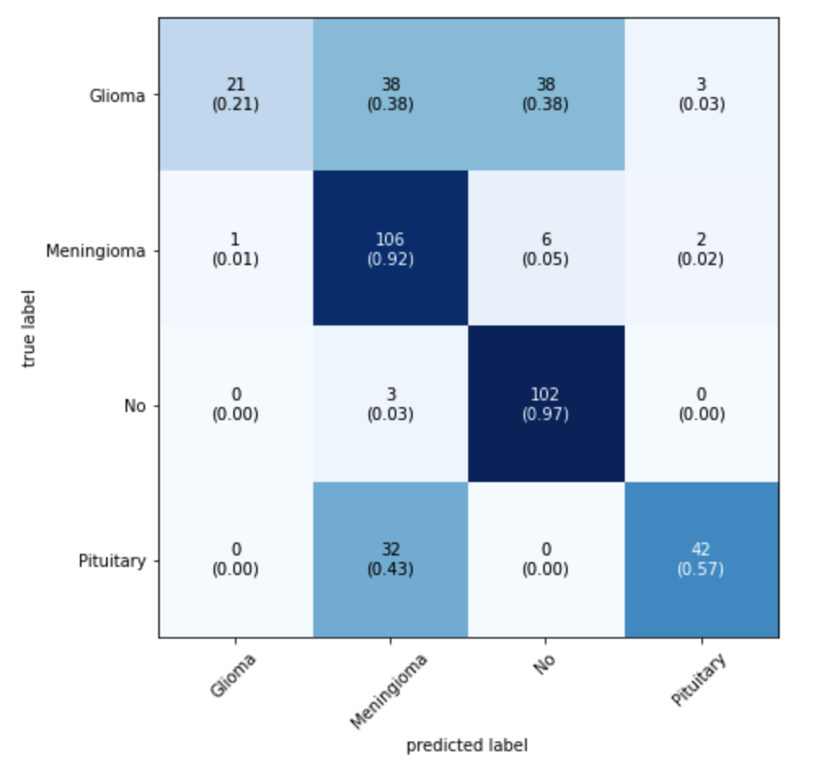
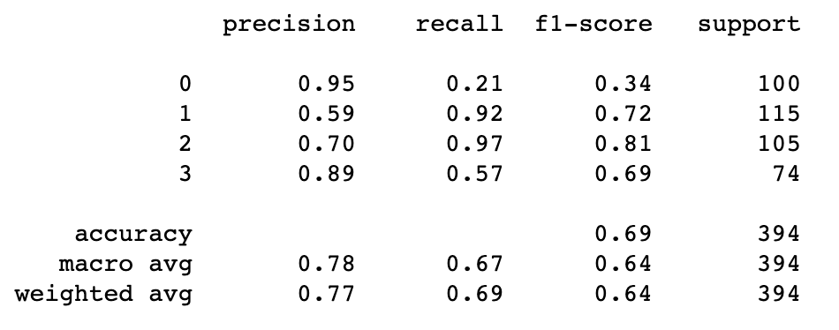
Holdout Set Results
Glioma
Meningioma
No
Pituitary

Slide 11
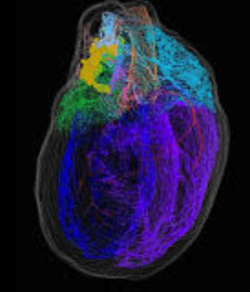
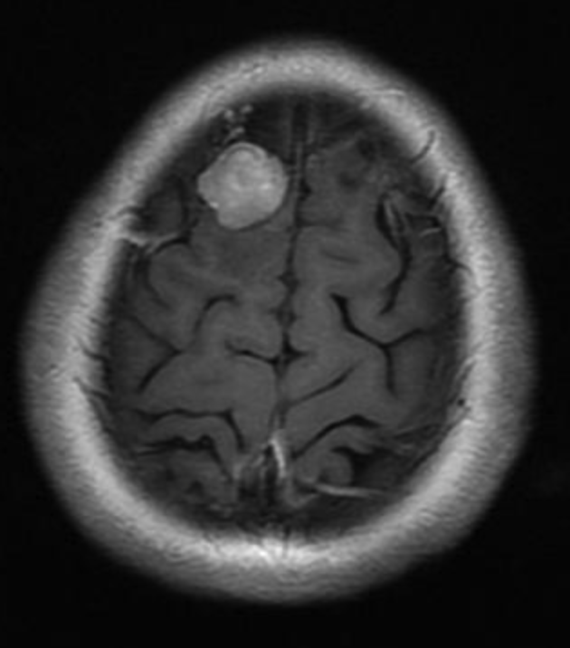
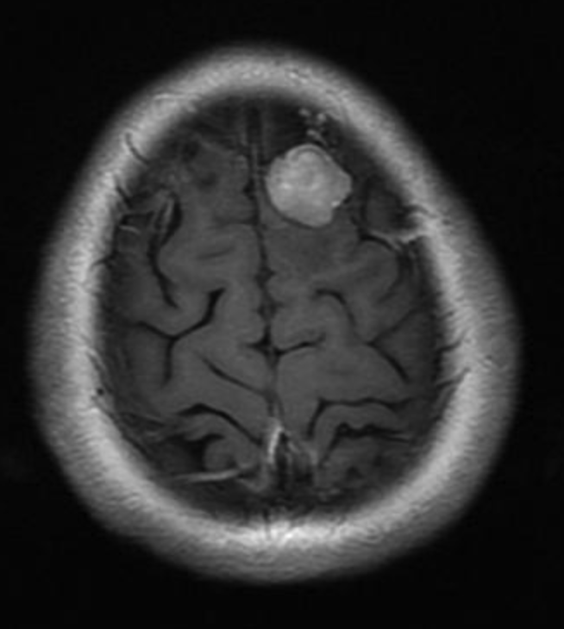
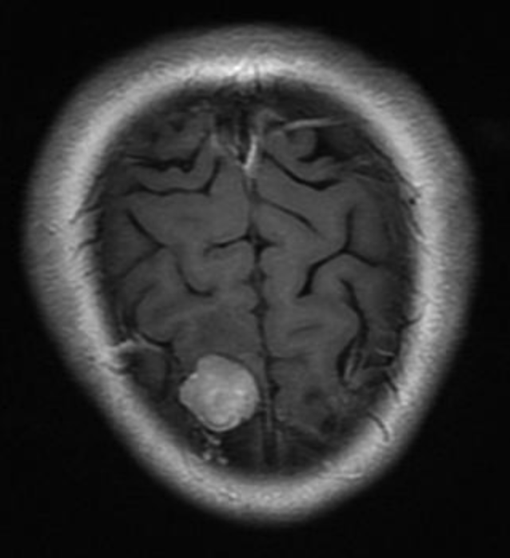
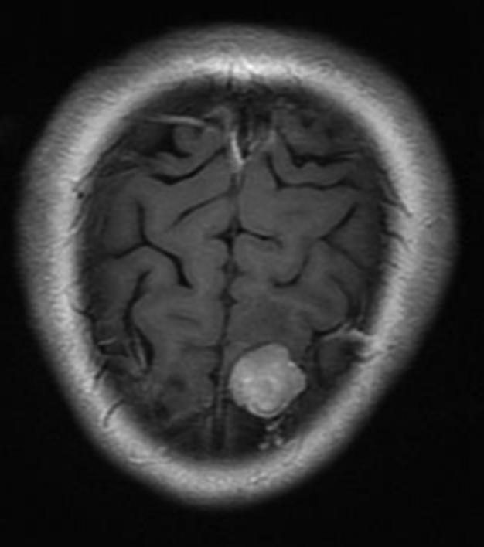
Future Work
Data Augmentation:
Which mainly focuses on the data rather than the network and the purpose is to expand the capabilities of the model.
Mirroring Horizontally and vertically
Translating
Rotating
Stretching
Resizing
Changing the color Balance
Contrast
Additional Noise
Add Blur

Slide 12
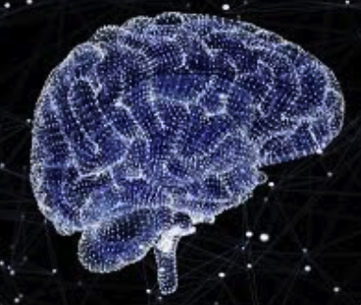
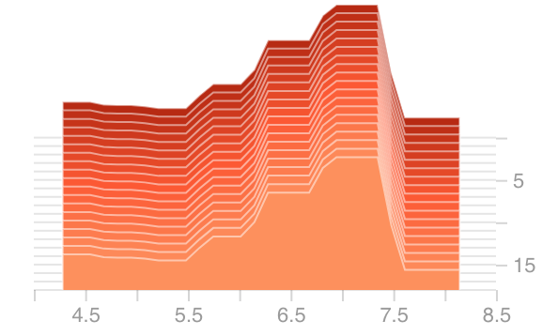
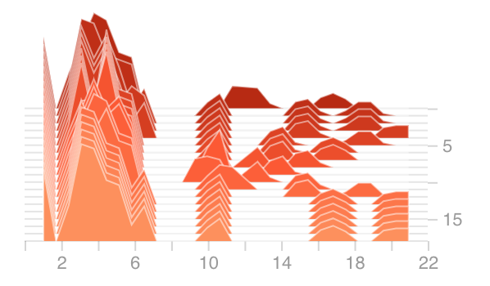
Recommendation
Using Tensorboard to visualize the histograms of the model
helps to optimize model much faster.
It gives you the ability to check the process of learning
In each single neuron in all layers of network.

Slide 13
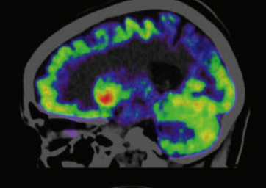
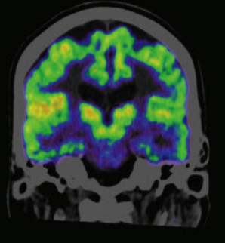
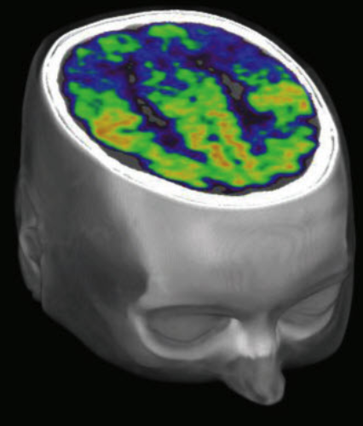
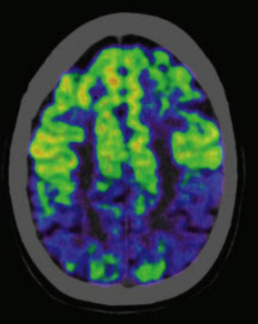
Recommendation
There are other medical imaging techniques including
1. CT (Computed Tomography) Scan
2. PET (Positron Emission Tomography) Scan
A combination PET-CT scan produces 3D images for
a more accurate diagnosis.

Slide 14
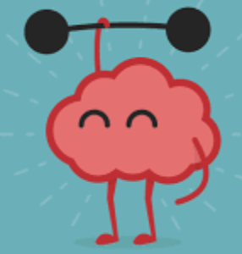
Thank You!
E-mail: ali.mahzoon.1989@gmail.com

